Slide 1


Capstone Project Review #1
Early detection of Pulmonary fibrosis
with Machine Learning

Slide 2
Capstone Project Review 7th Sem
Project Title : Early detection of Pulmonary fibrosis with Machine Learning
Project ID : Capstone24; EC20
Project Guide : Prof. Lakshmeesha Sir

Slide 3
Outline
Objective
Introduction
Motivation and Scope of the Project
Literature Survey
Design block diagram and flowchart
Capstone (Phase-II & Phase-III) Project Timeline using gantt chart.
Conclusion
References

Slide 4
ABSTRACT
Fibrosis
Can be normal healing or pathological.
Involves connective tissue deposition.
Extracellular Matrix (ECM)
Helps in tissue repair.
Excess ECM causes fibrosis/scarring.
Fibrotic Process
Severe progression → organ failure.
Can lead to death
Note: Scarring results in the thickening and stiffening of the affected tissue, leading to the disruption of normal structure and function.

Slide 5
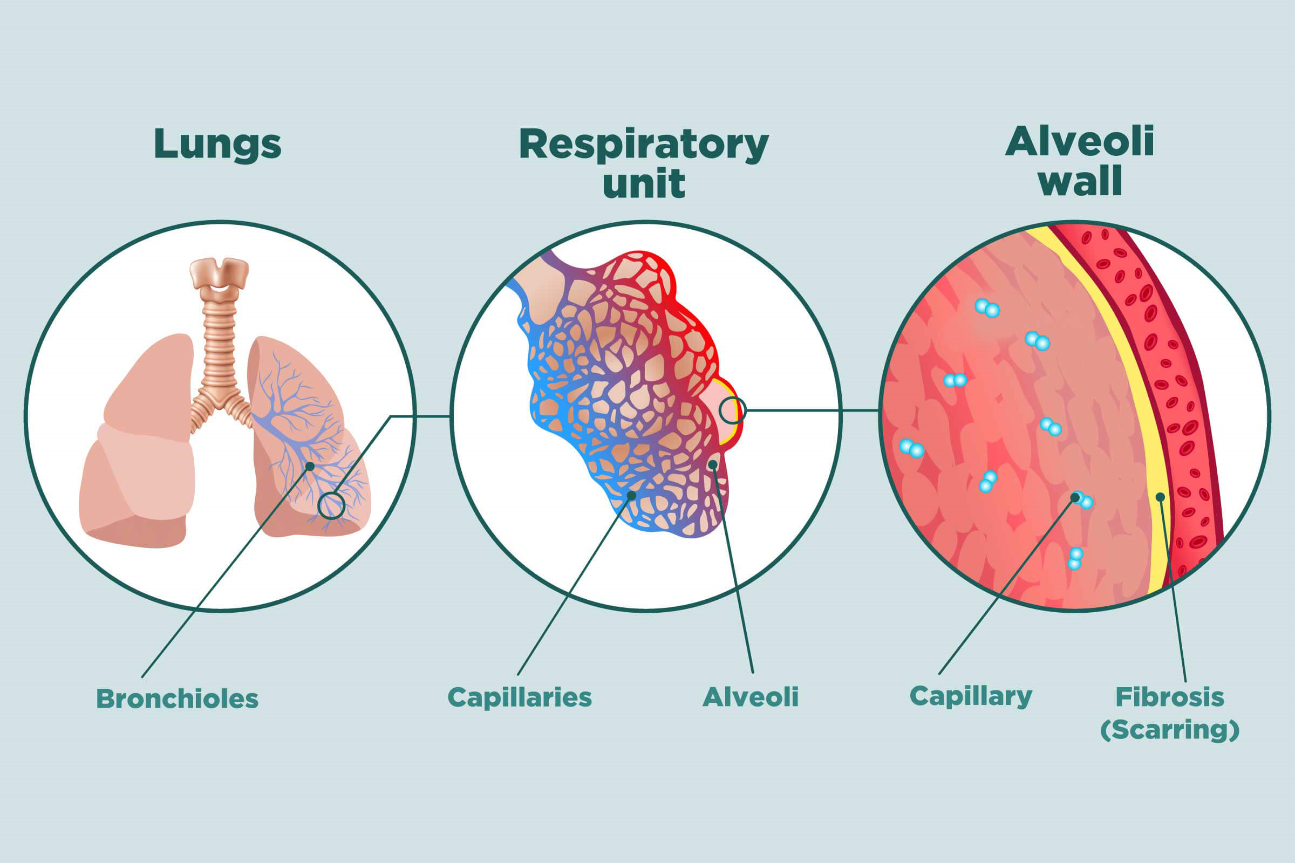

Slide 6
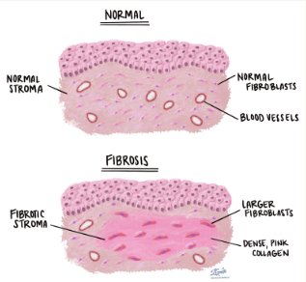
Idiopathic pulmonary fibrosis (IPF) is a serious chronic (long term) disease that affects the tissue surrounding the air sacs, or alveoli, in the lungs
|--> It worsens over time.
Fibrosis & Pulmonary Fibrosis

Slide 7
Fibrosis Begins at the lower lung zone
Symptoms – The dependencies
Shortness of breath – After walking shorter distances
Dry cough – For about months to years
Aching muscles and joints Loss of appetite
Chest discomfort
Tobacco smoking
Connective tissue diseasesDecrease in SPO2
Crepitations - Crepitations in the lungs are crackling or popping sounds that can be heard or felt when breathing
ABG – Tests the amount of O2 & CO2 present -a low oxygen level on an ABG test can suggest significant lung fibrosis is present.
Reticulonodular opacities - Reticulonodular opacities appear as fine, web-like (reticular) structures mixed with small nodules spread throughout the lungs.
Lung texture change due to honeycombing patterns
GGO [Ground glass opacity] - appears as hazy, cloud-like regions where the lung tissue is partially filled with fluid, inflammatory cells, or thickened interstitial tissue.
Early diagnosis and treatment of IPF may increase lifespan and preserve quality of life.

Slide 8
Constraints / Dependencies / Assumptions
Legal Implications
Data Privacy & Ethics: The project must comply with HIPAA (Health Insurance Portability and Accountability Act), GDPR (General Data Protection Regulation), and local regulations if patient data is involved.
Usage Limitations
Complementary to Expert Diagnosis: The system should be used as an assistive tool, not as a replacement for radiologists or pulmonologists.
Software Dependencies:
Machine Learning Frameworks: TensorFlow, PyTorch, or Scikit-learn.
Image Processing Libraries: OpenCV, PIL (Python Imaging Library).
Medical Imaging Tools: DICOM libraries (e.g., pydicom) for processing chest X-rays or CT scans.
Development Environment: Jupyter Notebook, Google Colab, or a high-performance computing setup.
Hardware Dependencies:
Sound Acquisition: Electronic microphone must be used in order to acquire auscultation

Slide 9
Existing Technologies
Non – Invasive Detections:
High-resolution computed tomography (HRCT) scan
Exhaled breath analysis - Spirometers
Lung auscultation sounds – by Impulse Oscillometer (IOS)
Electromyography
Forced vital capacity - through forceful breathing
Invasive Detections:
Surgical Lung Biopsy (SLB)
broncoscopy
VideoAssisted Thoracoscopic Surgery
Transbronchial Lung Cryobiopsy

Slide 10
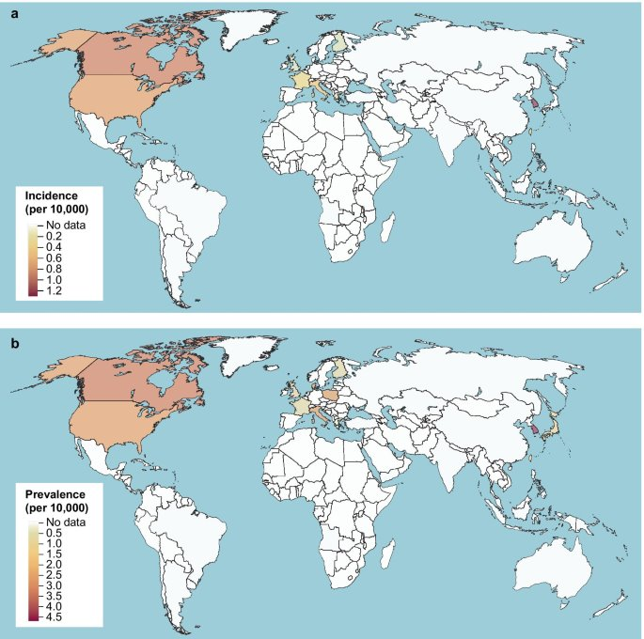
The number of new cases of IPF per 10,000 people in different countries.
Pulmonary Fibrosis is more frequently reported in developed countries
(North America, Europe, Japan).
The Distribution

Slide 11
Literature Survey
Paper Details | Objective of paper, Techniques/Methods | Advantages | Limitations
2025 Predicting Risk of Pulmonary Fibrosis Formation in PASC Patients |  |  | Presence of misclassification
2025 AI-Driven Early Prediction of Pulmonary Fibrosis Using Deep Learning | \ |  | Data Imbalance Lack of Clinical Validation Limited Generalization
2025 Predicting Pulmonary Fibrosis Progression Using EfficientNet-LSTM Model: A Hybrid Approach

Slide 12
Paper Details | Objective of paper, Techniques/Methods | Advantages | Limitations
2025 Unraveling Pulmonary Fibrosis Deep Learning Transfer Learning for Diagnosis |  |  | Presence of misclassification
2025 High-Performance Detection of Pulmonary Diseases in CT Images Using PFC-DenseNet121 and Binary Robust Independent Elementary Features | \ |  | Data Imbalance Lack of Clinical Validation Limited Generalization
2024 Elevating Cystic Fibrosis Detection in Lungs using HRCT Images with a Cutting-Edge CNN-Based Approach

Slide 13
Paper Details | Objective of paper, Techniques/Methods | Advantages | Limitations
2024 Prediction Of Pulmonary Fibrosis Disease |  |  | Presence of misclassification
2024 FibroRegNet: A Regression Framework for the Pulmonary Fibrosis Prognosis Prediction Using a Convolutional Spatial Transformer Network | \ |  | Data Imbalance Lack of Clinical Validation Limited Generalization
2024 Detection of Idiopathic Pulmonary Fibrosis Lesion Area Based on Transfer Learning

Slide 14
Paper Details | Objective of paper, Techniques/Methods | Advantages | Limitations
2024 Enhanced Pulmonary Pattern Classification in HRCT Images Using Advanced Data Augmentation Strategies and Fine-Tuned CNN Models |  |  | Presence of misclassification
2024 Accurate Prediction of Pulmonary Fibrosis Progression Using EfficientNet and Quantile Regression: A High Performing Approach | \ |  | Data Imbalance Lack of Clinical Validation Limited Generalization
2024 Identification of Molecular Biomarkers and Key Pathways among Idiopathic pulmonary fibrosis (IPF), Chronic Obstructive Pulmonary Disease (COPD) and Lung cancer

Slide 15
Paper Details | Objective of paper, Techniques/Methods | Advantages | Limitations
2024 Enhanced Pulmonary Pattern Classification in HRCT Images Using Advanced Data Augmentation Strategies and Fine-Tuned CNN Models |  |  | Presence of misclassification
2024 Accurate Prediction of Pulmonary Fibrosis Progression Using EfficientNet and Quantile Regression: A High Performing Approach | \ |  | Data Imbalance Lack of Clinical Validation Limited Generalization

Slide 16
Paper Details | Objective of paper, Techniques/Methods | Advantages | Limitations
2024 Identification of Molecular Biomarkers and Key Pathways among Idiopathic pulmonary fibrosis (IPF), Chronic Obstructive Pulmonary Disease (COPD) and Lung cancer |  |  | Presence of misclassification
2023 Domain Generalization for Diagnosis of Pulmonary Fibrosis Using Dose-Invariant Feature Selection | \ |  | Data Imbalance Lack of Clinical Validation Limited Generalization
2023 Enhanced Fusion Approach to Diagnose ILD and Improve Patient Outcomes

Slide 17
Paper Details | Objective of paper, Techniques/Methods | Advantages | Limitations
2023 Improving Idiopathic Pulmonary Fibrosis Damage Prediction with Segmented Images in a Deep Learning Model |  |  | Presence of misclassification
2023 AI Approaches for Pulmonary Disease Forecast | \ |  | Data Imbalance Lack of Clinical Validation Limited Generalization
2023 Lung Function Decline Predicting Using Improved EfficientNet

Slide 18
Paper Details | Objective of paper, Techniques/Methods | Advantages | Limitations
2022 A combined CNN-LSTM and LSTM-QRNN model for prediction of Idiopathic Pulmonary Fibrosis Progression using CT Scans and Clinical Data |  |  | Presence of misclassification
2022 Scalable Regression Model for Pulmonary Fibrosis | \ |  | Data Imbalance Lack of Clinical Validation Limited Generalization
2022 Estimating Lung Capacity in Pulmonary Fibrosis Patients via Computerized Tomography (CT) Scan Data and Machine Learning

Slide 19
Paper Details | Objective of paper, Techniques/Methods | Advantages | Limitations
2022 Analysis of Idiopathic Pulmonary Fibrosis through Machine Learning Techniques |  |  | Presence of misclassification
2022 Prediction of Pulmonary Fibrosis Progression using CNN and Regression | \ |  | Data Imbalance Lack of Clinical Validation Limited Generalization
2021 Prediction Analysis of Idiopathic Pulmonary Fibrosis Progression from OSIC Dataset

Slide 20
Paper Details | Objective of paper, Techniques/Methods | Advantages | Limitations
2020 A regression-based machine learning approach for the prediction of lung function decline |  |  | Presence of misclassification

Slide 21
Goals
Technology Failure Risks
Model Performance Issues: The ML model may have low accuracy, leading to misdiagnoses.
Overfitting Risk: The model might perform well on the training set but fail on new data due to overfitting.
Data Preprocessing Errors: Poor quality or noisy data can lead to inaccurate model predictions.
Challenges in Early Detection:
La
L
Project Goal:
D
A

Slide 22
Goals
Technology Failure Risks
Model Performance Issues: The ML model may have low accuracy, leading to misdiagnoses.
Overfitting Risk: The model might perform well on the training set but fail on new data due to overfitting.
Data Preprocessing Errors: Poor quality or noisy data can lead to inaccurate model predictions.
Challenges in Early Detection:
La
L
Project Goal:
D
A

Slide 23
Expected Deliverables
Capstone-II deliverables
Data Collection & Preprocessing Plan
Machine Learning Model Development
Capstone-III deliverables
Model Evaluation & Testing
Prototype App Development
Capstone-IV deliverables
Model Optimization & Fine-Tuning
End-to-End System Integration
User Testing & Validation

Slide 24
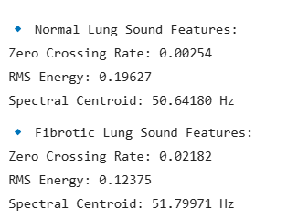
The Model
Stage | Action Performed
Input Acquisition | Accept X-ray, lung sound, and symptoms data from users
Preprocessing | Noise reduction, image enhancement, feature extraction
ML Model Processing | CNN for X-rays, Spectrogram CNN for lung sounds, Decision model for symptoms
Fusion & Risk Prediction | Model combines inputs to determine fibrosis risk level
Output Generation | Visual reports, probability scores, and personalized health recommendations
Security & Compliance | Data encryption
ZCR – High for fibrotic lung
RMS Energy – Lower for fibrotic lung
Fibrotic Lung sounds are at high frequency |– High spectral Centroid

Slide 25
References
https://www.pulmonaryfibrosis360.com/pcp/suspecting-pulmonary-fibrosis/act-when-you-hear-dry-inspiratory-crackles
https://pubmed.ncbi.nlm.nih.gov/29914454/
Computer-Aided Diagnosis System for Lung Fibrosis: From the Effect of Radiomic Features and Multi-Layer-Perceptron Mixers to Pre-Clinical Evaluation
https://www.mayoclinic.org/diseases-conditions/pulmonary-fibrosis/symptoms-causes/syc-20353690
https://drkalpeshpanchal.com/facts-about-pulmonary-fibrosis/
https://www.news-medical.net/health/What-is-Fibrosis.aspx
https://pmc.ncbi.nlm.nih.gov/articles/PMC9963026/
https://www.mypathologyreport.ca/pathology-dictionary/fibrosis/

Slide 26
Thank You

